Slide 1
Analytical Methods for Business
Dr. Ronald K. Satterfield
Muma College of Business
University of South Florida

Slide 2
Analysis of Variance When Life Comes At You In Lumps
Dr. Ronald K. Satterfield
Muma College of Business
University of South Florida

Slide 3
Key Idea in Analysis of Variance
Analyzing Variation in the Dependent Variable by Categories in the Independent Variable.
Introduction | One Way | Assumptions | Two Way | Conclusions
Notes:
3

Slide 4
Important Terms
Dependent Variable
Factor (Analog to the Independent Variable)
Level (Categories in the Independent Variable)
Introduction | One Way | Assumptions | Two Way | Conclusions

Slide 5
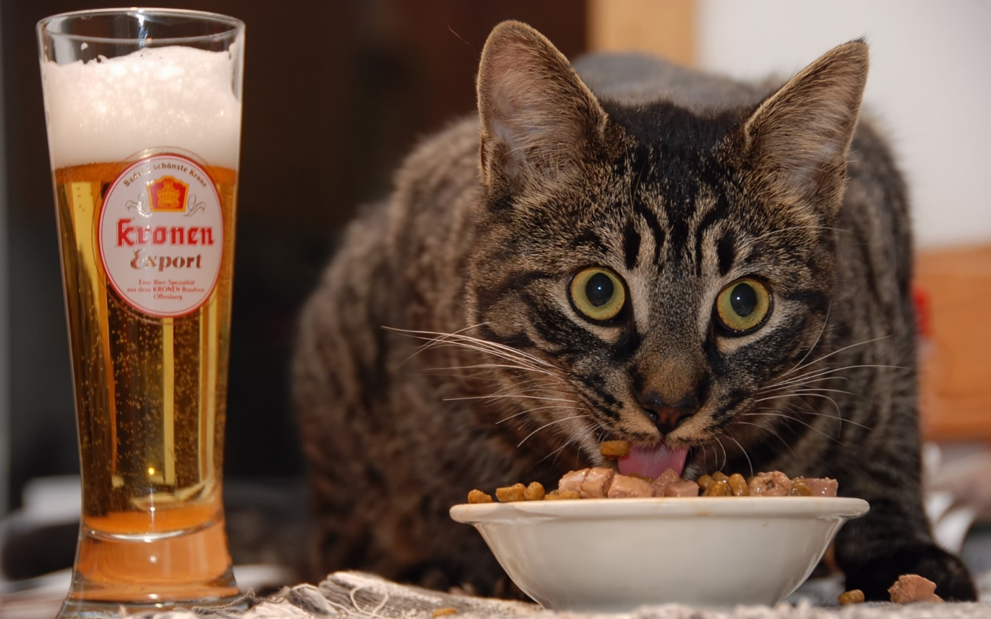
One Way Analysis of Variance
Introduction | One Way | Assumptions | Two Way | Conclusions
Notes:
5

Slide 6
Assumptions of ANOVA
Randomness and Independence
Normality
Homogeneity (Equality) of Variances
Introduction | One Way | Assumptions | Two Way | Conclusions
Notes:
6

Slide 7
Assumptions of ANOVA
Randomness and Independence
Normality
Homogeneity of Variances
Observations are random, no dependency between observations. Here, cats are randomly chosen and how much food of one flavor a cat eats does not impact the amount of any other flavor eaten or the amount any other cat eats.
Introduction | One Way | Assumptions | Two Way | Conclusions
Notes:
7

Slide 8
Assumptions of ANOVA
Randomness and Independence
Normality
Homogeneity of Variances
Samples from each group are from normally distributed populations. Simple tests for this, but ANOVA is very forgiving on this assumption.
Introduction | One Way | Assumptions | Two Way | Conclusions
Notes:
8

Slide 9
Assumptions of ANOVA
Randomness and Independence
Normality
Homogeneity of Variances
The variances of the populations represented by the groups are equal. This is similar to some assumptions in regression. There are tests discussed in the text for this.
Introduction | One Way | Assumptions | Two Way | Conclusions
Notes:
9

Slide 10
Testing Equality of Variances
Introduction | One Way | Assumptions | Two Way | Conclusions
Notes:
10

Slide 11
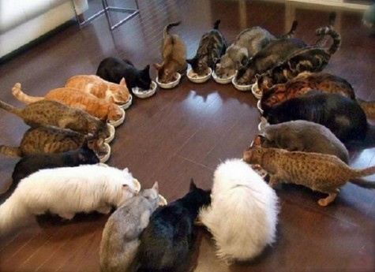
Randomized Block Design
Introduction | One Way | Assumptions | Two Way | Conclusions

Slide 12
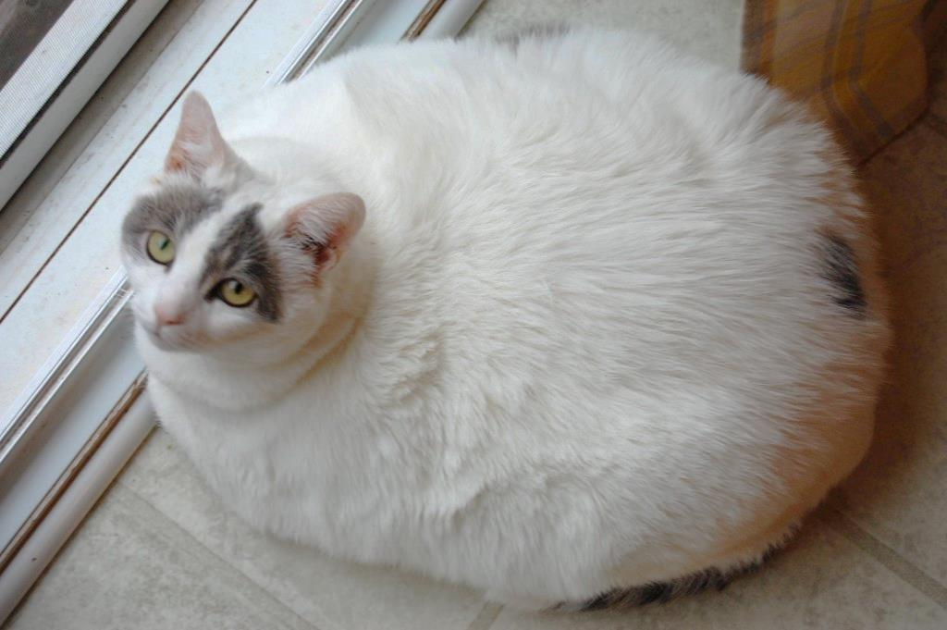
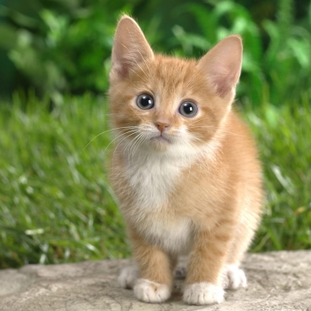
Adding Cats: Mr. Smooches and Itty-Bitty
Introduction | One Way | Assumptions | Two Way | Conclusions
Notes:
12

Slide 13
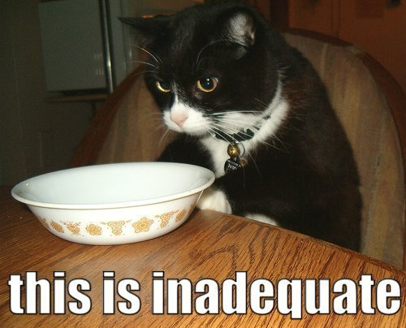
Conclusions
Basic Idea v. Regression
One Independent Variable
More than One Independent Variable
Assumptions
Equality of Variances Test
Introduction | One Way | Assumptions | Two Way | Conclusions
Notes:
13

